Slide 1
The upgrad of illumination optical
ECEI &MIR group
2019/7/29

Slide 2
Optical arrangement
Frist lens
gain lens
zoom lens(moveable)
window

Slide 3
questions
1.beam size
2.optical lens size
3.beamsplite size
4.curvature adjustable range
5.radius adjustable range

Slide 4
Beam size( gain lens to frist lens :2430mm)
Distance（e-f） | 20/mm | 100/mm | 200/mm | 300/mm | 350/mm
Mirror1(long side, 45^{O}) | 207 | 197 | 196 | 207 | 219
beamsplitter(long side, 45^{O}) | 342 | 315 | 291 | 281 | 281
Frist lens(550) | 498 | 441 | 377 | 318 | 292
Illumination radius (r=0.25m) | 133 (744) | 111 (687) | 80.5365 (558) | 46.5267 (356.2836) | 28 (232.5078)
The size of beamsplitter:460*610

Slide 5
Illumination size and adjustable curvature size

Slide 6
Robust analysis
$±1$0cm的测量误差可导致$±1$00cm（14%）的波前曲率误差和$±1$0(9%)的照明范围误差

Slide 7
Beam splitter
RO4730,板厚1.524mm，介电常数：3.0

Slide 8
Beamsplitter incident angle 80º

Slide 9
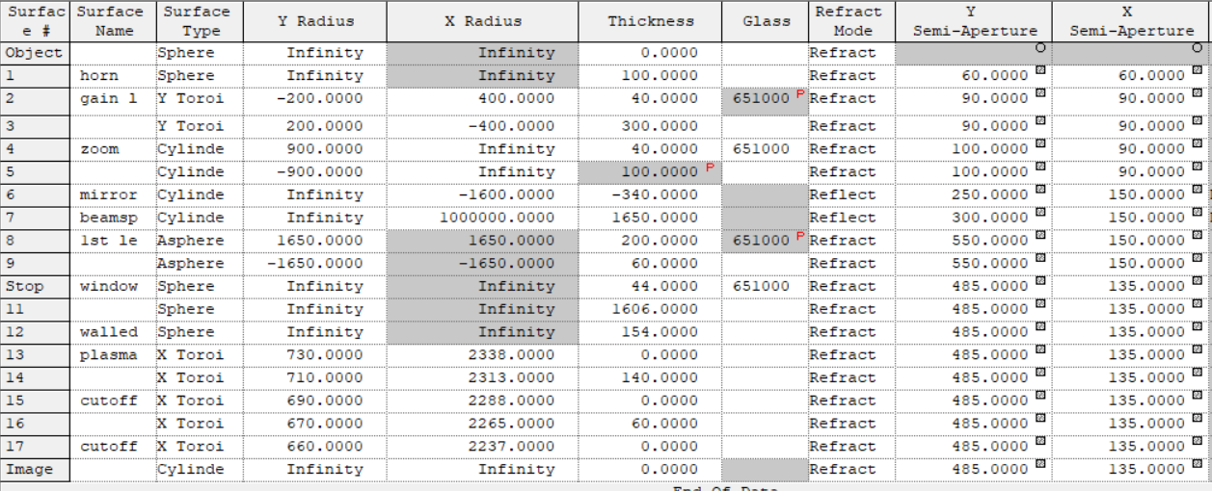
Raw data

Slide 10
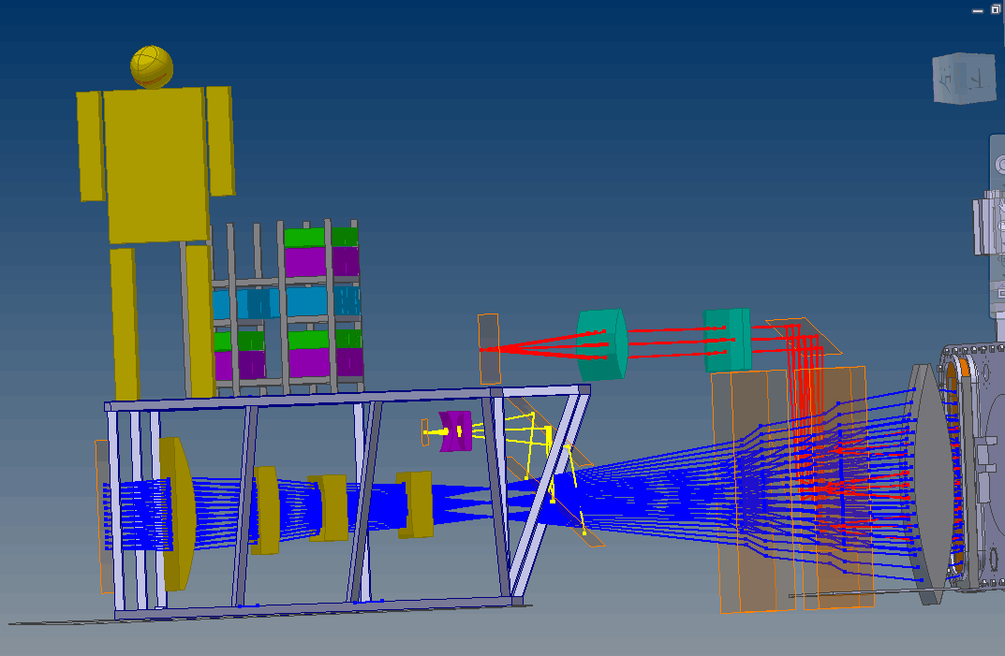
Made by qcm

